Slide 1
Hercules
What do you think of when you hear this name?

Slide 2
What is a historian?
A person who studies artifacts to learn more about the life during that time period.
Artifacts can be primary sources, or objects, letters, pictures, writing, etc. from that time period.
Artifacts can be secondary sources, or articles, books, pictures, etc. after that time period. Secondary sources often use primary sources for information. They summarize, analyze, or give opinions on the topic.

Slide 3
Who can be a historian?
Notes:
Encourage students to recognize that anybody--including themselves--can be historians

Slide 4
Your turn to be a historian...
Observe primary sources to learn more about the Hercules.
Think:
What IS the Hercules?
What was life like in the Hercules?
What are some important parts of the Hercules? What do they do?
What time period did/does the Hercules exist in?
What questions do you have about it?
Prove:
How can you support your thinking using information from the primary sources?

Slide 5
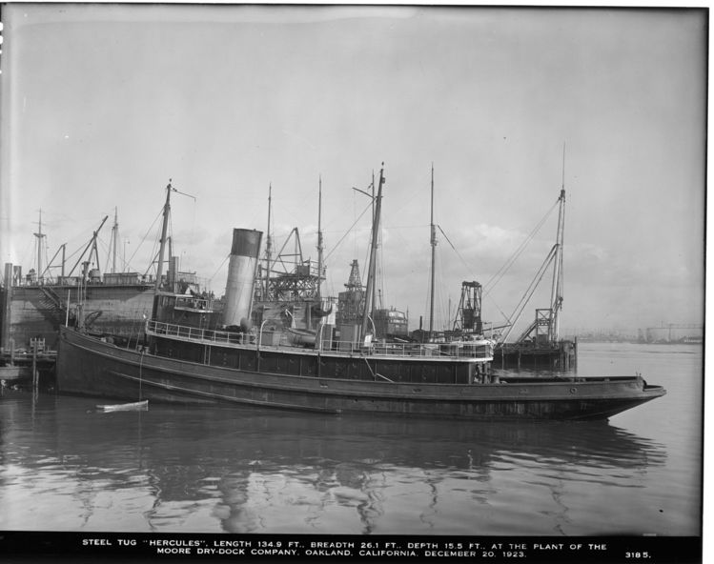
Let’s Practice!
Circa 1923
Observations & Proof:
Notes:
Examples could include: I know “Hercules” is an old boat because the picture was taken in 1923, I know that “Hercules” is a boat from the picture, etc.

Slide 6
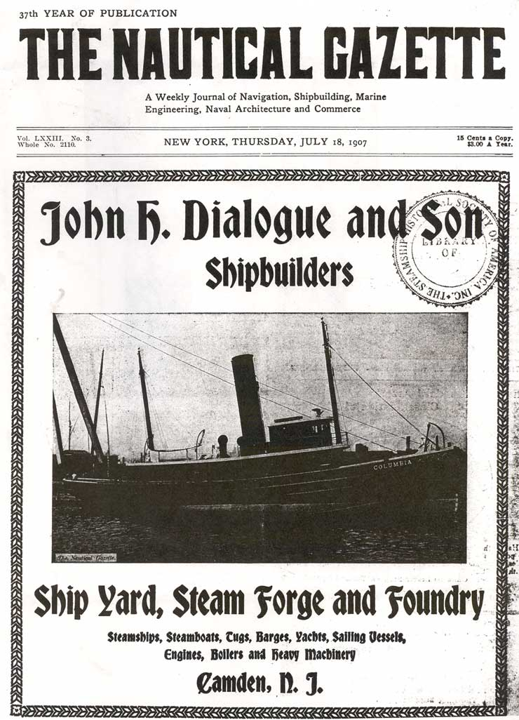
The Nautical Gazette
The Nautical Gazette, February 6, 1908:
“Two vessels left the Delaware River last week on what promises to be a memorable as well as record-breaking voyage. They were the new sea-going tugboats₁ Hercules and Goliath, built at the shipyard of John H. Dialogue & Son, ship and engine builders, Camden, N. J., for the Shipowners & Merchants' Tugboat Co., of San Francisco₂. They are bound for San Francisco, via the Straits of Magellan, and what is unusual, the Goliath is being towed by the Hercules. Both boats were built to burn oil as fuel, and with tanks well filled on either boat ,it is said there will be sufficient₃ fuel for the Hercules's boilers for the entire trip of about 14,000.miles...”
A powerful boat used for pulling other, larger boats
The boats sailed from New Jersey to San Francisco. They traveled across the United States.
Enough
Notes:
Review the concept of footnotes with students!

Slide 7
Let’s Practice Again!
Observations & Proof:
Hercules is a ship
It’s tugging Goliath
It was a boat and it used to burn oil to go 14,000 miles
The Goliath is a big boat
Goliath and Hercules are different names but are both boats and burn oil
Notes:
Examples could include: I know that “Hercules” is a tugboat because in the article it says, “Goliath is being towed by the Hercules”, I know that “Hercules” was built in Camden, New Jersey because in the article, it says the company that built it was there, etc.

Slide 8
Gallery Walk
You will have 4 minutes at each station to observe the primary source.
Think:
What IS the Hercules?
What was life like in the Hercules?
What are some important parts of the Hercules? What do they do?
What time period did/does the Hercules exist in?
What questions do you have about it?
Prove:
How can you support your thinking using information from the primary sources?
Sentence Frames:
I am noticing that...I think this because…
I think...because in the source…
I agree/disagree with this idea because…
I want to add on that...the proof is that...
Notes:
Gallery Walk: Print out materials. Create different stations around the room by placing one picture at each station. Students have 4 minutes at each station to think about the questions and respond on a post it note. As they rotate, they will leave their post it notes at that station.

Slide 9
Individual Reflection
Return to the stations to read about what your classmates wrote about each primary source. Think critically about their responses: Do you agree or disagree with them? Why?
When you are finished, go back to your seat and continue your individual reflection. What did you observe about the Hercules? What questions do you still have about it?

Slide 10
Class Reflection
What did you observe about the Hercules? What is your proof?
They used to eat fish because they was on a boat for a long time.
Ships helped them go places.
They lived in the boats.
They used oil to create fuel for the boat.
It was built in 1908
Its home was in San Francisco and it would sail through the ocean
It was a towboat

Slide 11
Class Reflection #2
What questions do you still have about Hercules?

Slide 12
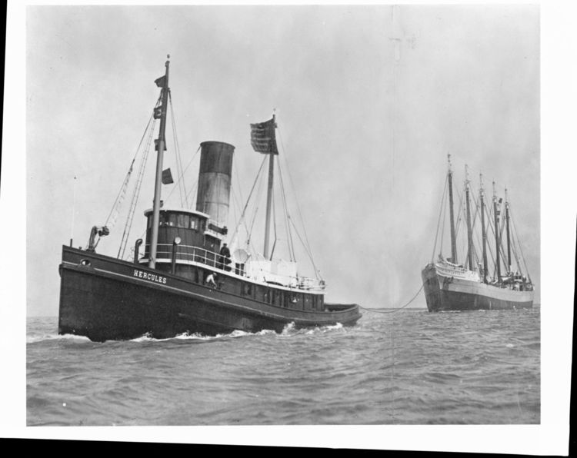
Revisiting the Question
Why do you think the tugboat was named Hercules?
Notes:
Students should be able to conclude that “Hercules” is a name for an extremely strong hero; Hercules the tugboat was also extremely strong because it tugged boats that were way bigger than it.

